Slide 1


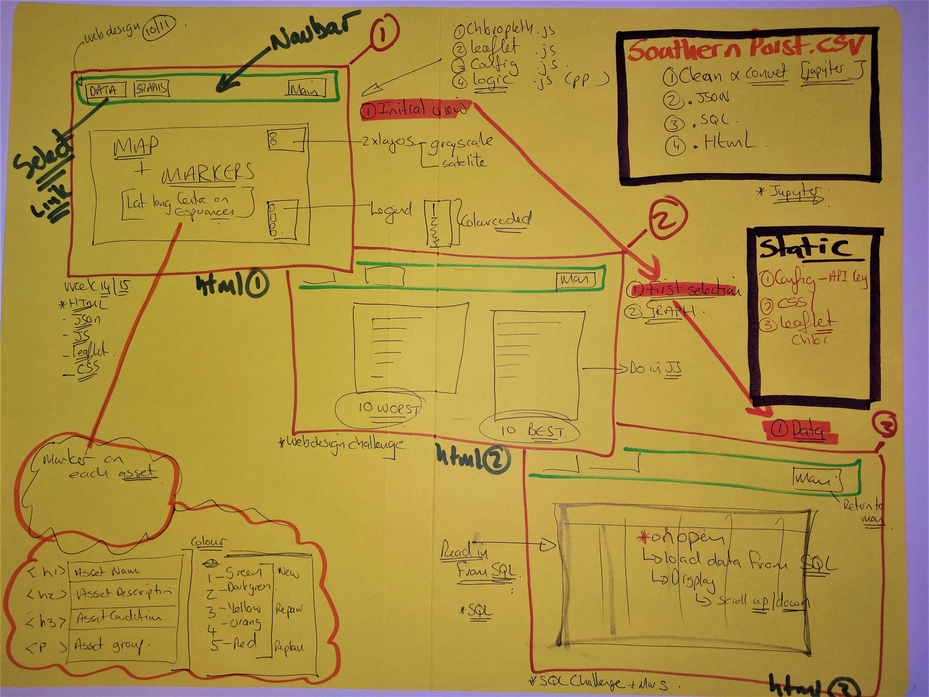
Week13,Project 2,Week14,Week 15
https://github.com/JohanfromEsperance
https://github.com/vn02063007
Base-map and one overlay
Southern Ports Datafile
Use ESPERANCE
Filter and Clean in Jupyter
TOP 10 Asset List
Johan
Minh
Relation Ship diagram
Clean and load to SQL version
Select Tob 10 assets
BARCHART to WEB page 2
HTML – INDEX
App.js
CSV Read in, Clean
CSV - JSON
LEAFLET
CSV Manipulations
OVERLAY
MARKERS
Marker data setup
See next page
Week15
LOAD and READ SQL link
Connect Link to HTML
Upload to WEB Page 3
LEGEND for condition data
Upload SQL file to WEBPAGE
Week8,9,19-0, Project2
https://johanfromesperance.github.io/Project-3-DataVisualization/

Slide 2


